Slide 1
Using Key Performance Indicators to Achieve Supply Management Optimization
Case Study from Loma Linda

Slide 2
Speakers
Russell Royer MBA, RCES, SA
Director, Heart and Vascular
LLUMC | International Heart Institute
RGRoyer@llu.edu
Office: 909-558-4000 ext. 15765
Lana Makhanik COO VUEMED, Inc.
lmakhanik@vuemed.com
www.linkedin.com/in/lana-makhanik-b501a2/
(888) 948-0999

Slide 3
Learning outcomes
Discuss the impact of UDI-compliant inventory management on financial, operational, and clinical processes/outcomes.
Develop KPIs for your organization to achieve inventory optimization and cost savings objectives
Recognize key functionalities of data capture solutions that meet the organization’s data/technology needs.
KPIs for Inventory Optimization – LLUH Case Study

Slide 4
About loma linda university med ctr
507-bed Academic Medical Center, part of Loma Linda University Health - a Seventh Day Adventist 6-hospital system
>1.5 million annual outpatients; the only Level I trauma center for a region that covers more than 25 percent of the state of California.
Named a Best Hospital for 2018-19 and "high performing" in seven areas by U.S. News & World Report
The Medical Center and East Campus were also awarded an “A” for Patient Safety from the Leapfrog Group’s Fall 2018 Safety Grade
Leading regional Heart & Vascular center through the International Heart Institute (IHI)
KPIs for Inventory Optimization – LLUH Case Study

Slide 5
What Challenges we need to solve
Treat Higher Patient Acuity . . .
. . . At Lower Costs
. . .With Excellent Outcomes
Supply Costs
Opportunities to address w/inventory management
Procedure Complexity
Inventory Carrying Costs
Unnecessary variation in utilization
Procedure Length
Ensure purchases align w/need
Ensure accurate data in patient records
Clinical Resources
Ensure accurate charge capture & billing
Ensure no expired product placed in patient
Clinical resources on non-clinical work
Ensure swift recall management
KPIs for Inventory Optimization – LLUH Case Study

Slide 6
Where we started
<50% of cases with accurate supplies data captured
>50% of items on-hand with no traceable purchase history
Fragmented & siloed management of items between clinical, supply chain, finance, and IT
Manual handling of all inventory-related tasks
No visibility of on-hand data
High rates of wasted and unused inventory
KPIs for Inventory Optimization – LLUH Case Study

Slide 7
Project goals
Gain full visibility and control over supply spend and utilization
Optimize inventory size and composition to meet clinical needs
Reduce unnecessary product variation
Ensure comprehensive and accurate charge capture
KPIs for Inventory Optimization – LLUH Case Study

Slide 8
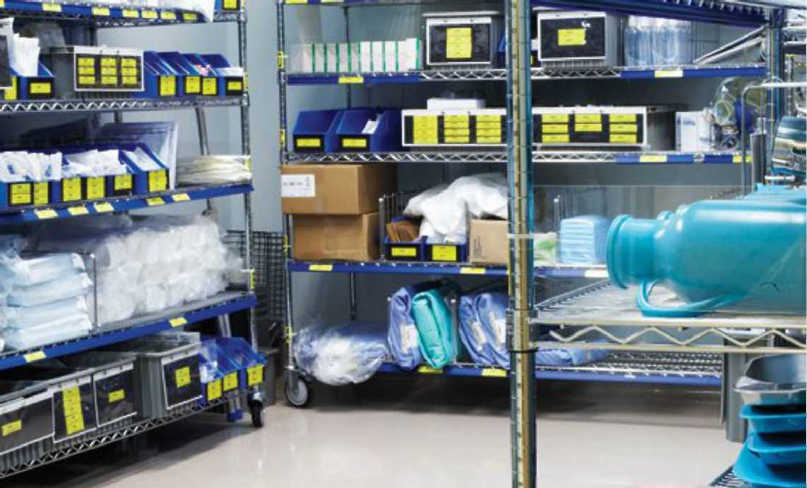
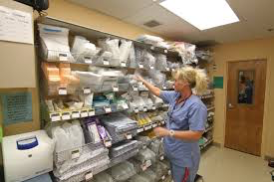
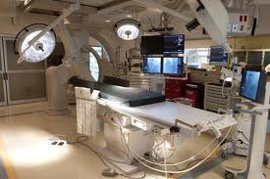
Solution setup
All data about products and their movements from delivery to point of care are recorded and fed into other hospital systems as well as the VUEMED Cloud for analyses and guidance
Point of Delivery
Point of Care
Delivery Area/Dock & Disposal
Supply Room
Procedure Room
Flow of Medical Products and Devices
Data Capture & Feed
Purchasing
EMR
Contracting
Hospital
MMIS
Clinical
Documentation
Systems
Billing
Distribution
Cloud Analytics
Procure-
ment
Value Analysis
Inventory availability
Par levels
Requisitions
Product accurate ID
All pedigree info
Exact quantities
Clinical
Analysis
KPIs for Inventory Optimization – LLUH Case Study

Slide 9
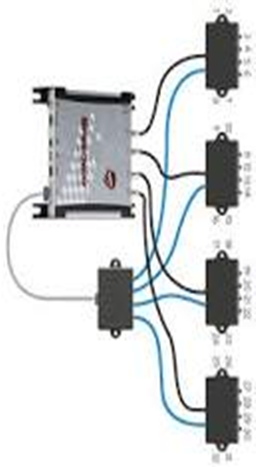
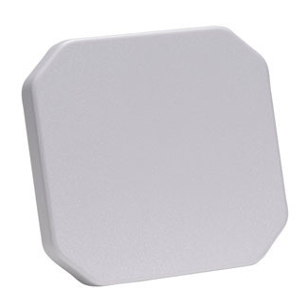
Rain rfid continuous process tracking
Tracks inventory in supply and procedure rooms, as well as movement throughout, and entry & exit from the department
Cloud & SaaS
Department and Boundaries Tracking
Any department or floor
Procedure Room
Procedure Room
Procedure Room
Supply Room
Main Entrance
Main Entrance
Hallway Movement Tracking
Exit door
Reception
Procedure Room
Procedure Room
KPIs for Inventory Optimization – LLUH Case Study

Slide 10
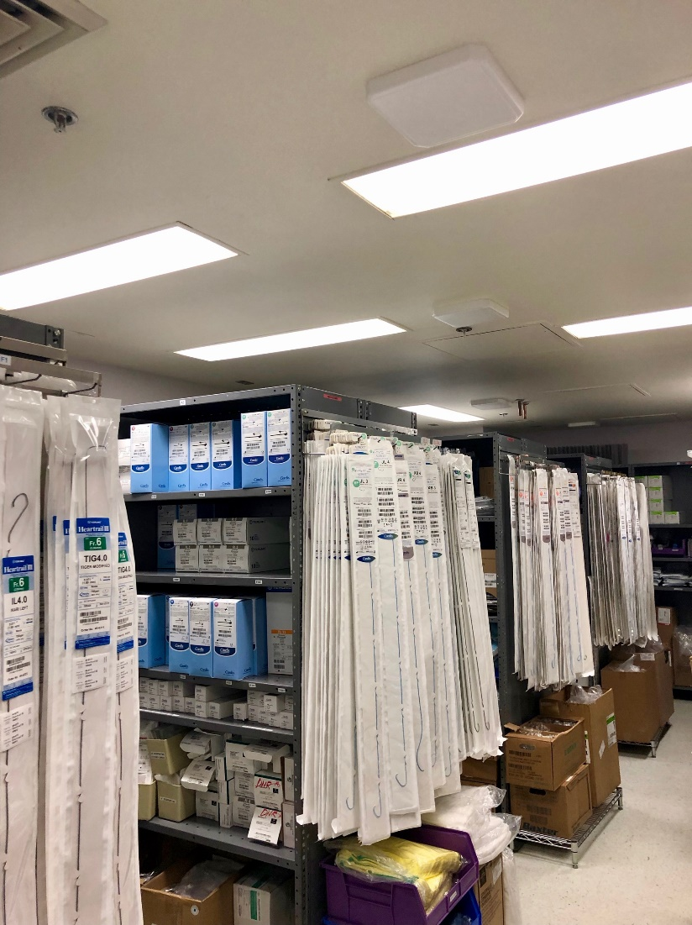
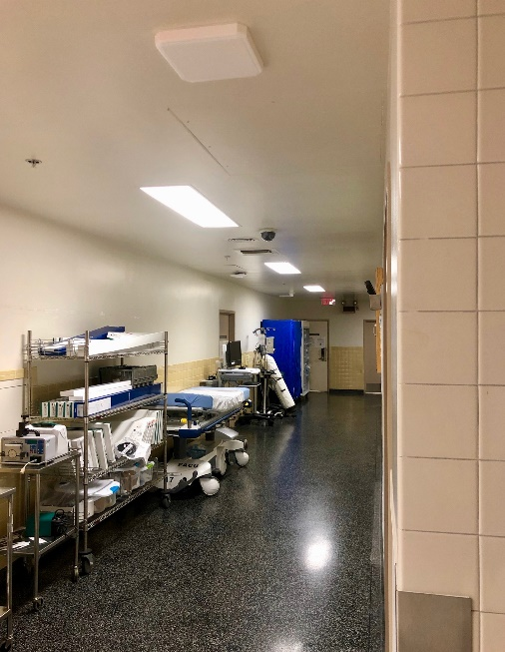
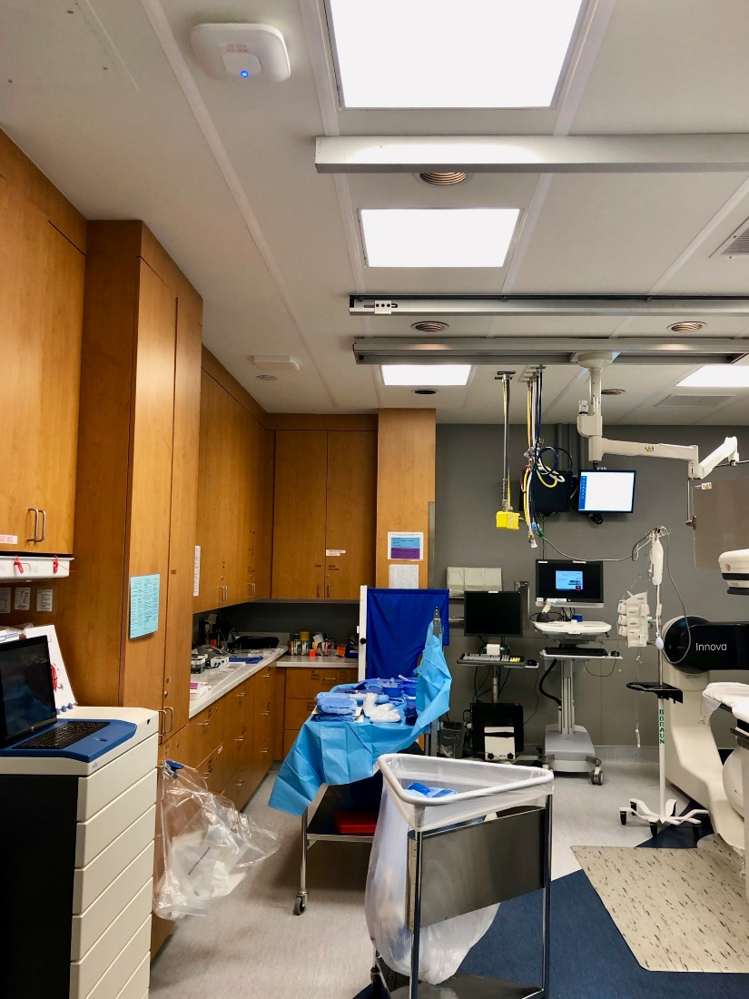
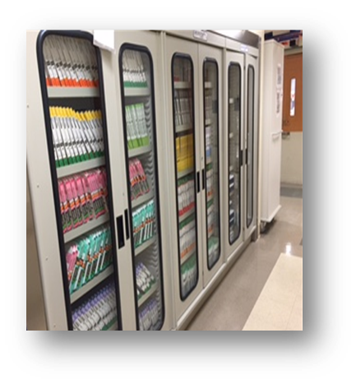
Fixed Rain rfid infrastructure footprint
Supply Rooms
Hallways / Cabinets
Procedure Rooms
Inside
KPIs for Inventory Optimization – LLUH Case Study

Slide 11
Organizational and process realignment
Process realignment & defining roles & responsibilities
Set up clearly defined daily/weekly/monthly protocols for all inventory-related activities:
Auditing & Reordering
Receiving & restocking
Expiration management
Item data management
Set up close collaboration & coordination with multiple departments and constituents:
Supply Chain
IT
Finance
KPIs for Inventory Optimization – LLUH Case Study

Slide 12
Organizational changes and leadership oversight
Resources reallocation
Standardized inventory management activities across 2 interventional departments and 4 locations
Inventory management staff moved to supply chain and cross-trained between departments
Leadership oversight
Agreed on a set of monthly KPIs for performance monitoring
Established accountability for following through on desired objectives
KPIs for Inventory Optimization – LLUH Case Study

Slide 13
The results so far…
Full visibility for each item from requisition to billing
Automated procure-to-pay processes
Measurably streamlined operations
Aligned purchases with consumption needs
Reduced recall management to minutes
By the Numbers:
Inventory value
unchanged
Case volume
unchanged
Expiring inventory
< 1%
Excess inventory
>60%
Cost per case
97%
Billing Accuracy
> 90%
KPIs for Inventory Optimization – LLUH Case Study

Slide 14
Building the key performance indicators
Typical Sources of Savings:
Metrics
Frequency
Expiration control
Expiring as % of total on-hand inventory: SKUs, Units, Value
Monthly
Inventory on-hand in relation to case volume: SKUs, Units, Value
Monthly
Inventory size reduction
Unused or infrequently used in the last 12 months as % of total on-hand inventory: SKUs, Units, Value
Quarterly
Purchased vs. consumed in relation to case volume: SKUs, Units, Value
Monthly
Reduction in product purchases
On-hand value of items above suggested par levels (given consumption history)
Quarterly
Opened not used totals and average per case: SKUs, Units, Value
Clinical utilization management
Monthly
Cost per each type of case per physician
KPIs for Inventory Optimization – LLUH Case Study

Slide 15
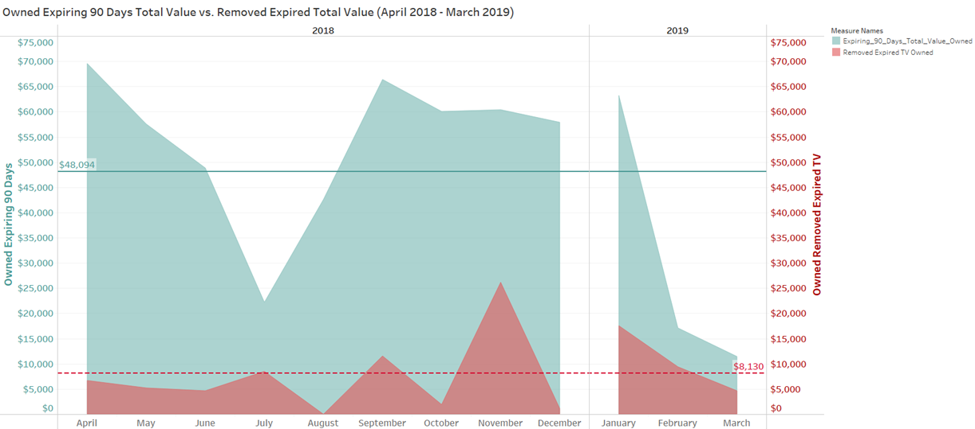
Building the key performance indicators
Expiration Management
KPIs for Inventory Optimization – LLUH Case Study

Slide 16
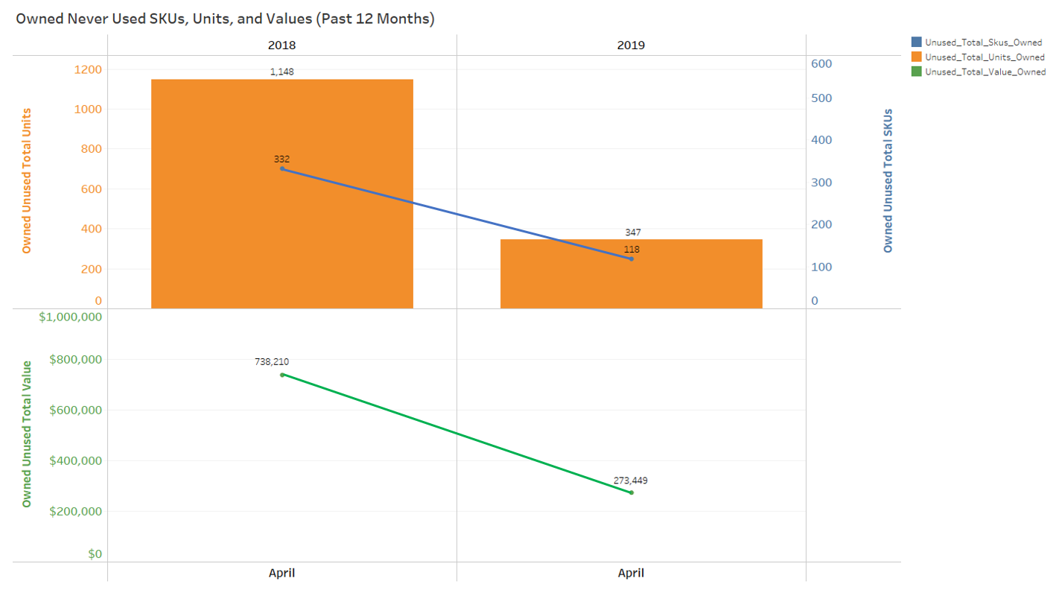
Building the key performance indicators
Unused Inventory Reduction
KPIs for Inventory Optimization – LLUH Case Study

Slide 17
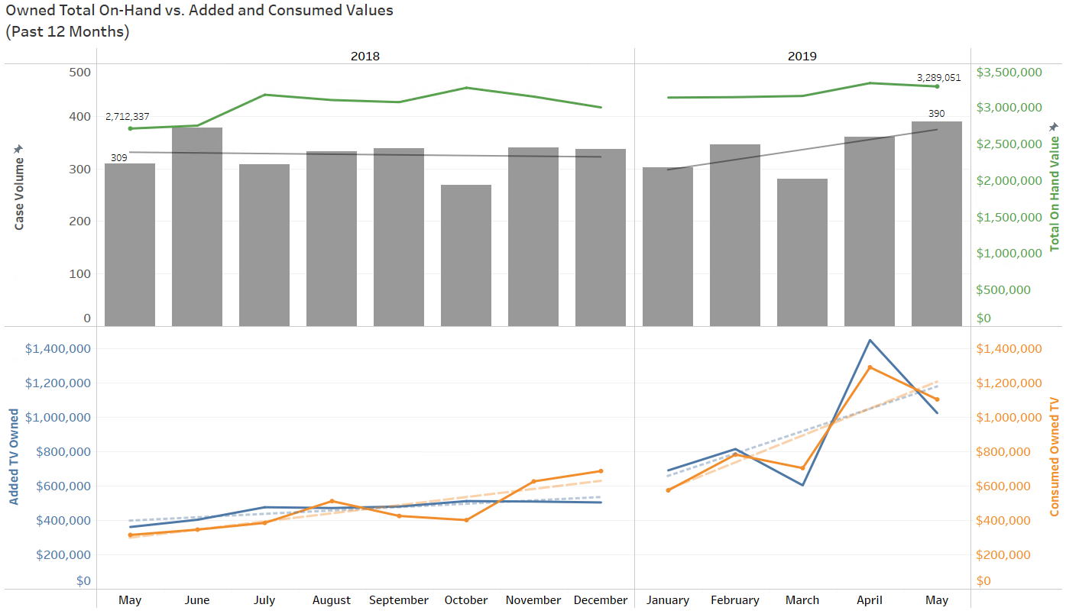
Building the key performance indicators
Alignment of Purchased and Consumed Inventory
KPIs for Inventory Optimization – LLUH Case Study

Slide 18
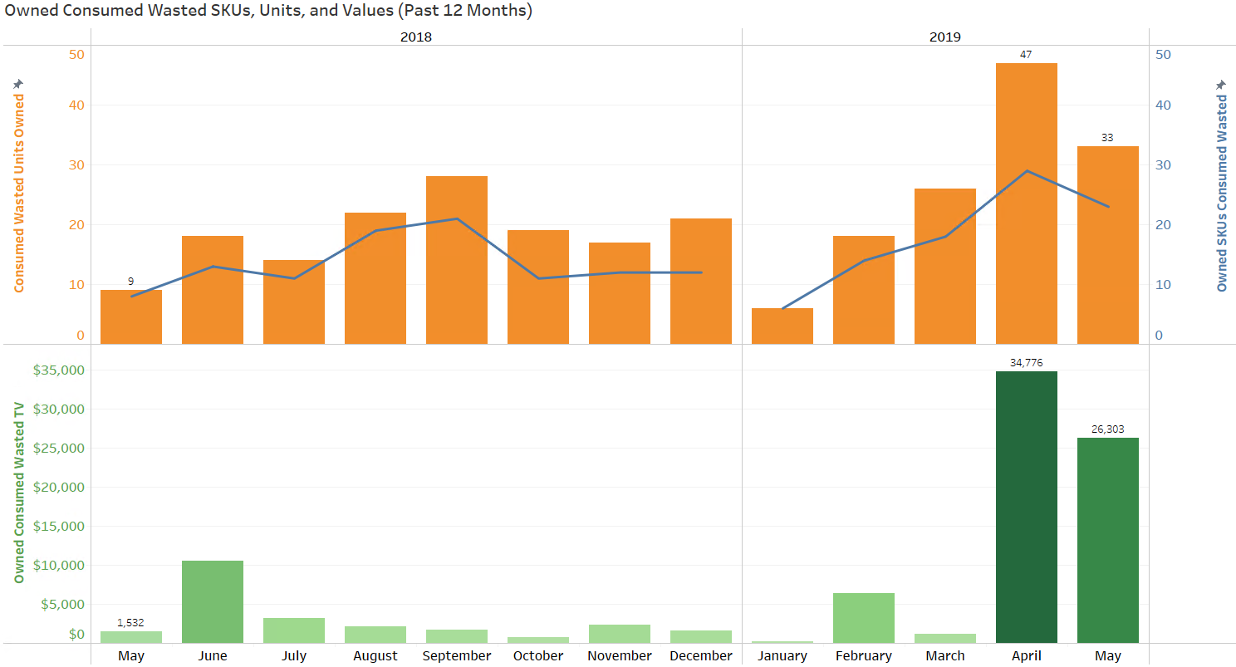
Building the key performance indicators
Monitoring Unnecessary Waste at Consumption (Items Opened Not Used)
KPIs for Inventory Optimization – LLUH Case Study

Slide 19
Lessons learned
Engage all the key stakeholders early in the process to ensure alignment and resource availability
Stagger implementation ideally not to coincide with other major projects
Establish a baseline starting point to measure progress from there
Ensure administrative and physician leadership commitment and support
Build strong collaboration with and get support from Supply Chain
Establish clear roles & responsibilities and accountabilities
Set up clear oversight mechanisms and performance expectations with supporting data & KPIs
KPIs for Inventory Optimization – LLUH Case Study

Slide 20
What’s next on this journey
We solve healthcare supply chain issues by establishing a demand-driven supply chain model. It starts with reliable data and its visibility between all industry partners.
We are focusing our efforts on understanding our own Cost/Value/Outcomes equation . . .
Examining cost per physician for same procedures
Eliminating variation & standardizing clinical practice/utilization
. . . And want to establish partnerships with suppliers who can support and contribute to our value equation
Suppliers need the data to help - we now have the data and ability to share it
KPIs for Inventory Optimization – LLUH Case Study

Slide 21
The Power of actionable data
Current dashboard:
KPIs for Inventory Optimization – LLUH Case Study

Slide 22
The Power of actionable data
Future example scenarios:
Virtual Case Carts
Supply demand planning based on scheduled cases (90%+ of cases are scheduled)
Use standardized “bill of materials” for each type of procedure
Expiration Management
Proactive view and management of expiring inventory
Typically inventory not used within 30 days of expiration, will expire unused
Predictive Analytics
Anticipate/sense the demand using accurate consumption data
Optimize inventory carrying costs
Proactively offer viable alternatives in case of recalls or backorders
Recall management (stock and patient notification)
Ability to instantly track the status of a recalled item and its location in the supply chain
Enable customers to quickly find & remove recalled items & notify patients if needed
KPIs for Inventory Optimization – LLUH Case Study

Slide 23
QUESTIONS

